Slide 1

Unit 2 18CSC203J-Computer Organization and Architecture

Slide 2
Course Outcome
CLR-2:Analyze the functions of arithmetic units like adders, multipliers etc.
CLR-6:Simulate simple fundamental units like half adder, full adder etc.
CLO-2:Apply Boolean algebra as related in designing computer logic through simple combinational and sequential logic circuits

Slide 3
Table of Contents
Addition and subtraction of signed numbers
Design of fast adders – Ripple Carry Adder and Carry Look ahead Adder
Multiplication of positive numbers
Signed operand multiplication
Fast multiplication - Bit pair recoding of Multipliers
Carry Save Addition of Summands
Integer division – Restoring Division and Non Restoring Division
Floating point numbers and operations

Slide 4
REPRESENTING BINARY INTEGERS
A computer has to process both positive and negative numbers called signed integers and/or simply signed numbers
Binary integer number can be represented using one of the following schemes:
Signed – Magnitude representation
Signed – 1’s complement representation
Signed – 2’s complement representation
For instance consider -13
Now -13 in binary as recorded in an 8-bit register look like:
1 0001101 → signed – magnitude form
1 1110010 → signed – 1’s complement form
1 1110011 → signed – 2’s complement form

Slide 5
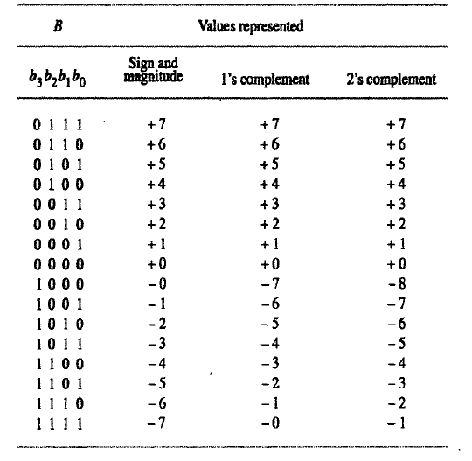

Slide 6

SUMMARY OF THE TABLE
SIGN & MAGNITUE SYSTEM: Negative value is obtained by changing the sign bit (MSB)
SIGNED 1’S COMPLEMENT: Negative number is obtained by complementing each bit of the corresponding positive number
An N-bit ones' complement numeral system can only represent integers in the range −(2^{N−1}−1) to 2^{N−1}−1
SIGNED 2’S COMPLEMENT: Negative number is obtained by taking 2’s complement of positive number

Slide 7
2s complement
Range of Numbers −An N-bit two‘s complement numeral system can only represent integers in the range −2^{N−1} to 2^{N−1}−1.
The advantage of this system is that 0 has only one representation for -0 and +0. Zero (0) is considered as always positive (sign bit is 0) in 2’s complement representation. Therefore, it is unique or unambiguous representation.

Slide 8
2’s complement addition of signed binary numbers
To add two numbers, add their n-bit streams including their sign bits and ignore the carry bit, if any
If any operand is Negative, then convert it into 2’s complement form, before Addition.
If sum obtained is Negative, then it’s in 2’s complement form.
Otherwise the result represent Algebraic sum

Slide 9
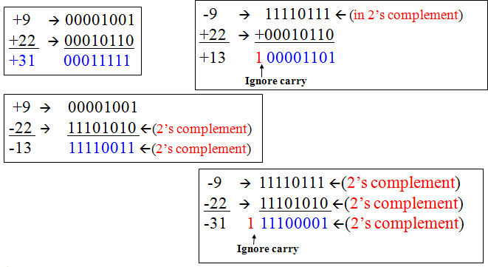
Examples of 2’s complement addition

Slide 10
2’ complement subtraction of signed binary numbers
Case 1:
Take the 2’s complement of the subtrahend (number to be subtracted) and add it to the minuend (including their sign bits). Discard carry bit if any
Case 2:
Suppose, if both minuend and subtrahend are Negative numbers, convert them in to 2’s complement form and perform Addition! Discard carry bit if any.

Slide 11
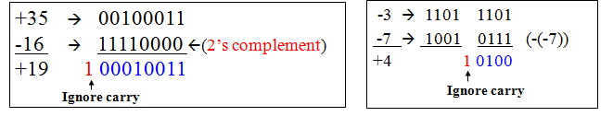
2’ complement subtraction of signed binary numbers

Slide 12
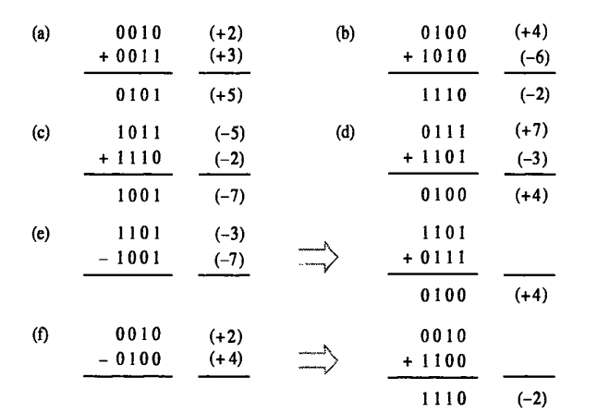

Slide 13
Representing Characters
ASCII Code: For coding alphanumeric data in binary form
ASCII - American Standard Code for Information Interchange.
It uses 7 bit binary code to represent each character.
2⁷ = 128, a maximum of 128 characters can be represented
ASCII code for ‘A’ is 1000001
for ‘a’ is 1100001
EBCDIC Code: For coding alphanumeric data in binary form
EBCDIC - Extended Binary Coded Decimal Interchange Code.
It uses 8 bit binary code to represent each character.
2⁸ = 256, a maximum of 256 characters can be represented

Slide 14
Characters
A memory word can also store character information such as alphabets, decimal digits, symbols like +, -, $, ?, punctuation marks like; :,’ “ etc., Such characters can be represented using a 7-bit ASCII code. Memory Word Bit pattern to represent characters

Slide 15
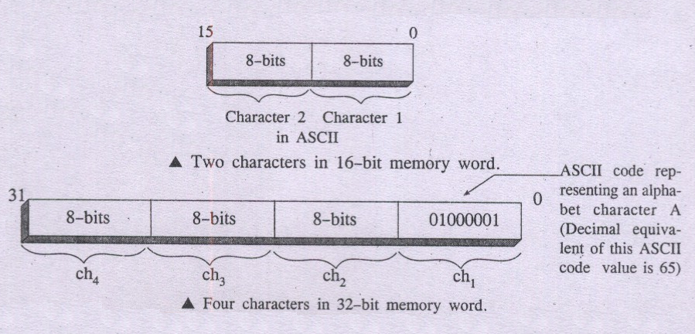

Slide 16
Half Adder
Half adder is a combinational logic circuit with two input and two output. The half adder circuit is designed to add two single bit binary number A and B. It is the basic building block for addition of two single bit numbers. This circuit has two outputs carry and sum.

Slide 17
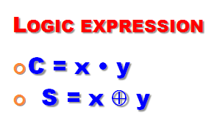
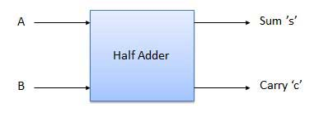
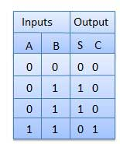
BLOCK DIAGRAM
X
A
Y
S
Y
B
XOR 2
A
Y
C
B
AND 2

Slide 18
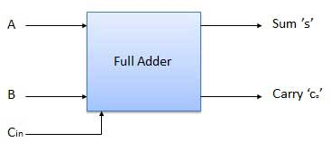
Full Adder
Full adder is developed to overcome the drawback of Half Adder circuit. It can add two one-bit numbers A and B, and carry c. The full adder is a three input and two output combinational circuit.

Slide 19
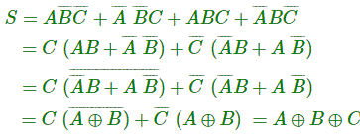
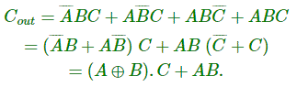
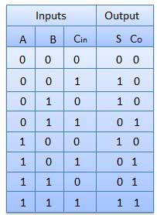
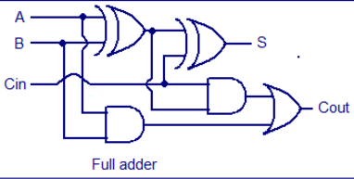
Truth Table and Circuit Diagram

Slide 20
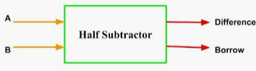
Half Subtractor
Half subtractor is a combination circuit with two inputs and two outputs (difference and borrow). It produces the difference between the two binary bits of the input and also produces another output called Borrow to indicate if a 1 has been borrowed. In the subtraction (A-B), A is called as Minuend bit and B is called as Subtrahend bit.

Slide 21
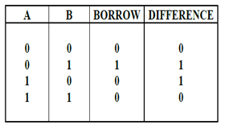
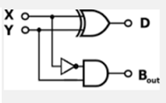
Truth Table and Circuit Diagram
From the truth table, Boolean Expression can be derived as:
D = A’B + AB’ = A ⊕ B
B_{o} = A’B

Slide 22
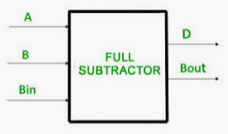
Full Subtractor
The disadvantage of a half subtractor is overcome by full subtractor. The full subtractor is a combinational circuit with three inputs A, B, Bin and two output D and Bo. A is the minuend, B is subtrahend, Bin is the borrow produced by the previous stage, D is the difference output and Bo is the borrow output.

Slide 23
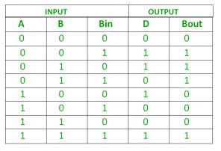
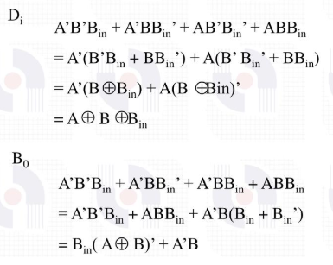
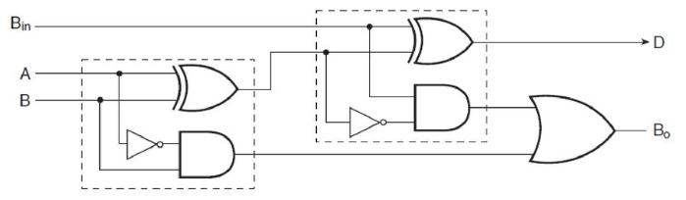
Half Subtractor
Half Subtractor

Slide 24
Ripple Carry Adder
Typical Ripple Carry Addition is a Serial Process:
• Addition starts by adding LSBs of the augend and addend.
• Then next position bits of augend and addend are added along with the carry (if any) from the preceding bit.
• This process is repeated until the addition of MSBs is completed.

Slide 25
Carry Propagation
• Speed of a ripple adder is limited due to carry propagation or carry ripple.
• Sum of MSB depends on the carry generated by LSB.
For example.
4-bit Carry Ripple Adder

Slide 26
Carry Propagation
Assume you want to add two operands A and B where
A= A3 A2 A1 A0
B=B3 B2 B1 B0
For example: A= 1 0 1 1
+ B= 1 1 0 1
---------------
A+B=1 1 0 0 0

Slide 27
Carry Propagation
From the example above it can be seen that we are adding 4 bits at a time sequentially until all bits are added.
A full adder is a combinational circuit that performs the arithmetic sum of three input bits: augends Ai, addend Bi and carry in Cin from the previous adder.
Its results contain the sum Si and the carry out, Cout to the next stage.

Slide 28
4 BIT ADDER
So to design a 4-bit adder circuit we start by designing the 1 –bit full adder then connecting the four 1-bit full adders to get the 4-bit adder as shown in the diagram.
For the 1-bit full adder, the design begins by drawing the Truth Table for the three input and the corresponding output SUM and CARRY.
The Boolean Expression describing the binary adder circuit is then deduced.
The binary full adder is a three input combinational circuit which satisfies the truth table below.

Slide 29
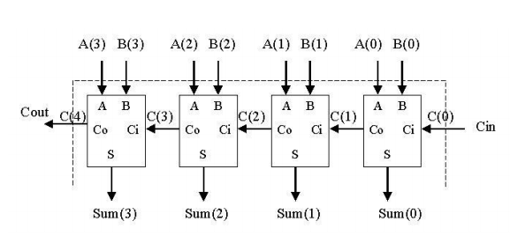
4-Bit Adder

Slide 30
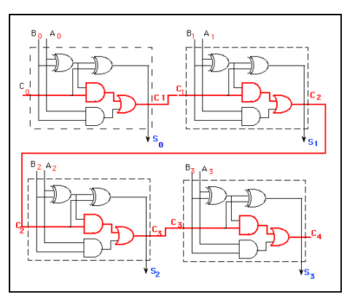
4-Bit Ripple Carry Adder

Slide 31

Design of Fast adder: Carry Look-ahead Adder
A carry-look ahead adders (CLA) is a type of adder used in digital logic. A carry-look ahead adder improves speed by reducing the amount of time required to determine carry bits.
It can be contrasted with the simpler, but usually slower, ripple carry adder for which the carry bit is calculated alongside the sum bit, and each bit must wait until the previous carry has been calculated to begin calculating its own result and carry bits (see adder for detail on ripple carry adders)

Slide 32
Design of Fast adder: Carry Look-ahead Adder
The carry-look ahead adder calculates one or more carry bits before the sum, which reduces the wait time to calculate the result of the larger value bits.
In a ripple adder the delay of each adder is 10 ns , then for 4 adders the delay will be 40 ns.
To overcome this delay Carry Look-ahead Adder is used.

Slide 33
Design of fast Adders
In n bit ripple carry adder, the delay for identifying S₀ through S_{n-1} and c_{n} is high
Two approaches can be taken to reduce delay in adders.
Use the fastest possible electronic technology.
Use a logic gate network called a carry-look ahead network.

Slide 34
Carry Look-ahead Adder
Different logic design approaches have been employed to overcome the carry propagation delay problem of adders.
One widely used approach employs the principle of carry look-ahead solves this problem by calculating the carry signals in advance.
A fast adder circuit must speed up the generation of the carry signals
This type of adder circuit is called as carry look-ahead adder (CLA adder). A carry signal will be generated in two cases:
(1) when both bits A_{i} and B_{i} are 1, or
(2) when one of the two bits is 1 and the carry-in (carry of the previous stage) is 1.

Slide 35
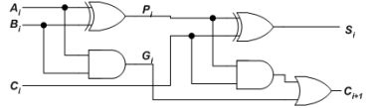
Carry Look-ahead Adder
The Figure shows the full adder circuit used to add the operand bits in the i^{th} column; namely A_{i} & B_{i} and the carry bit coming from the previous column (C_{i} ).

Slide 36
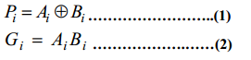
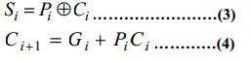
Carry Look-ahead Adder
In this circuit, the 2 internal signals Pi and Gi are given by:
The output sum and carry can be defined as

Slide 37
Carry Look-ahead Adder
G_{i} is known as the carry Generate signal since a carry (C_{i+1}) is generated whenever G_{i} =1, regardless of the input carry (C_{i}).
P_{i} is known as the carry propagate signal since whenever P_{i} =1, the input carry is propagated to the output carry, i.e., C_{i+1} = C_{i} (note that whenever P_{i} =1, G_{i} =0).
Computing the values of P_{i} and G_{i} only depend on the input operand bits (A_{i} & B_{i}) as clear from the Figure and equations.
Thus, these signals settle to their steady-state value after the propagation through their respective gates.

Slide 38
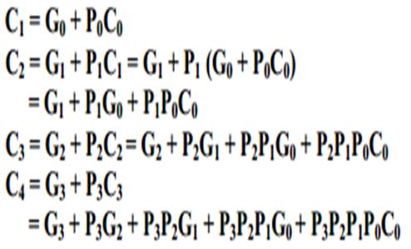
4-bit Carry Look-ahead Adder
Computed values of all the P_{i}’s are valid one XOR-gate delay after the operands A and B are made valid.
Computed values of all the G_{i}’s are valid one AND-gate delay after the operands A and B are made valid.
The Boolean expression of the carry outputs of various stages can be written as follows:

Slide 39
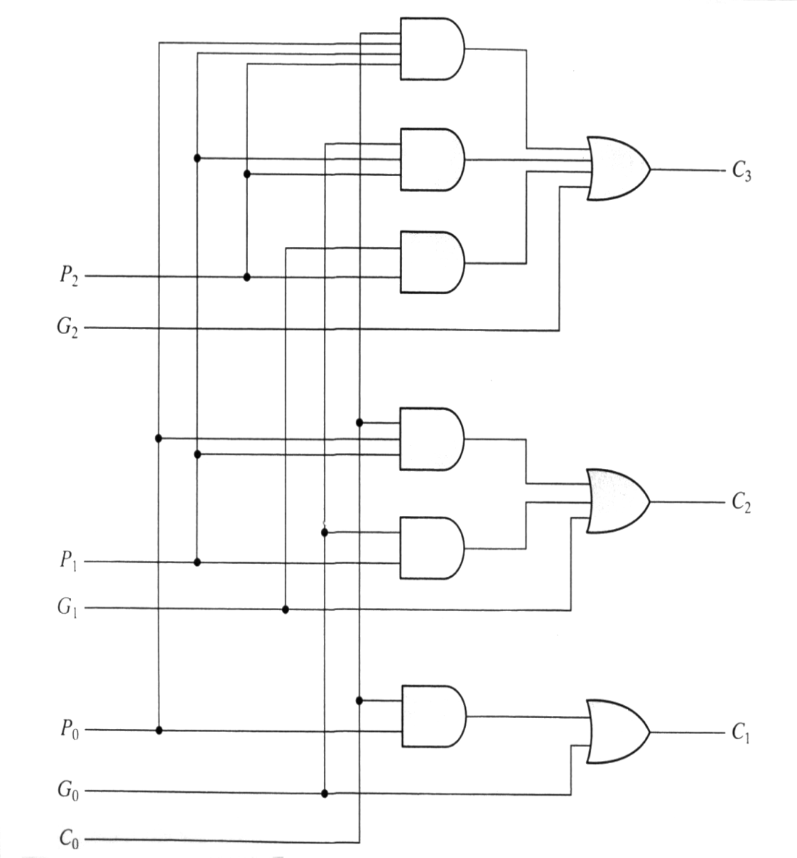
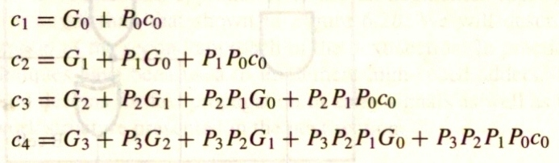
4-bit adder Carry Look-ahead Adder
Implementing these expressions (for a 4-bit adder), results in the logic diagram. (IC- 74182)

Slide 40
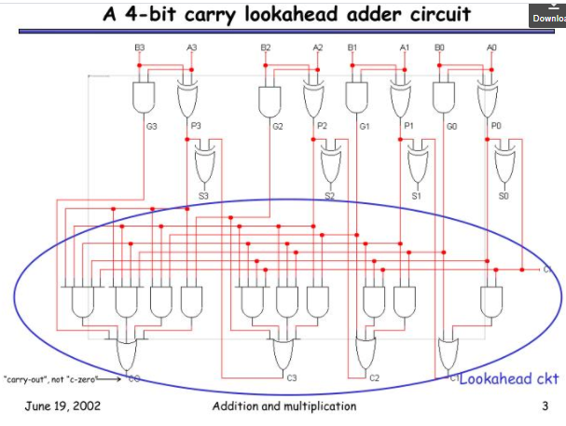

Slide 41
4-bit Carry Look-ahead Adder
Like ripple carry adder we need not to wait for the propagation of carries to get the sum.
independent of n,
the n-bit addition process requires only four gate delays (against 2n)
C_{i+1}-- in 3 Gates delay; S_{i} – in 4 Gates delay irrespective of n. C₁ in 3 gates delay,C₂ in 3 gates delay,C₃ in 3 gates delay and so on.
S₀ in 4 gates delay, S₁ in 4 gates delay, S₂ in 4 gates delay and so on.

Slide 42
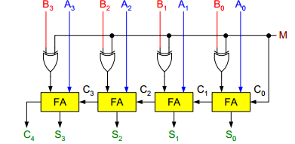
Binary Parallel Adder/Subtractor:
The addition and subtraction operations can be done using an Adder-Subtractor circuit.
The figure shows the logic diagram of a 4-bit Adder-Subtractor circuit.

Slide 43
Binary Parallel Adder/Subtractor:
The circuit has a mode control signal M which determines if the circuit is to operate as an adder or a subtractor.
Each XOR gate receives input M and one of the inputs of B, i.e., Bi. To understand the behavior of XOR gate consider its truth table given below.

Slide 44
If one input of XOR gate is zero then the output of XOR will be same as the second input. While if one input of XOR gate is one then the output of XOR will be complement of the second input.

Slide 45
Binary Parallel Adder/Subtractor:
So when M = 0, the output of XOR gate will be Bi ⊕ 0 = Bi. If the full adders receive the value of B, and the input carry C0 is 0, the circuit performs A plus B.
When M = 1, the output of XOR gate will be Bi ⊕ 1 = Bi. If the full adders receive the value of B’, and the input carry C0 is 1, the circuit performs A plus 1’s complement of B plus 1, which is equal to A minus B.

Slide 46
Multiplication of Positive Numbers Binary Multiplier
Multiplication of binary numbers is performed in the same way as with decimal numbers. The multiplicand is multiplied by each bit of the multiplier, starting from the least significant bit.
The result of each such multiplication forms a partial product. Successive partial products are shifted one bit to the left.
The product is obtained by adding these shifted partial products.
Example 1: Consider multiplication of two numbers, say A and B (2 bits each),
C = A x B.

Slide 47
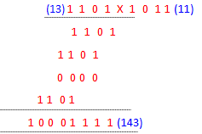
Binary Multiplier
Unsigned number multiplication
two n-bit numbers; 2n-bit result

Slide 48
Binary Multiplier
The first partial product is formed by multiplying the B1B0 by A0. The multiplication of two bits such as A0 and B0 produces a 1 if both bits are 1; otherwise it produces a 0 like an AND operation. So the partial products can be implemented with AND gates.
The second partial product is formed by multiplying the B1B0 by A1 and is shifted one position to the left.
The two partial products are added with two half adders (HA). Usually there are more bits in the partial products, and then it will be necessary to use FAs.

Slide 49
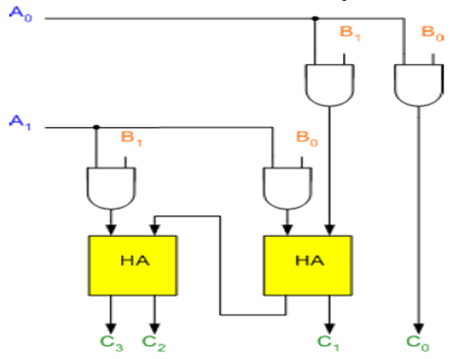
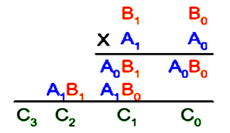
Binary Multiplier

Slide 50
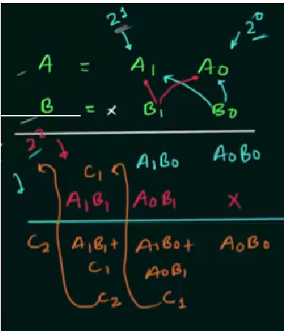
Binary Multiplier

Slide 51
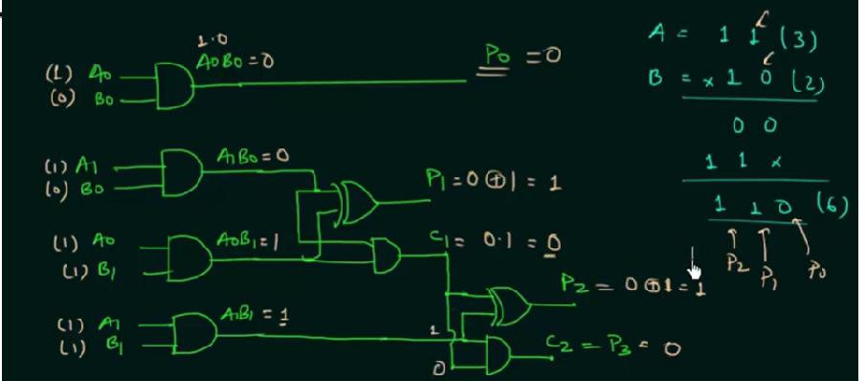
Binary Multiplier

Slide 52
Binary Multiplier
The least significant bit of the product does not have to go through an adder, since it is formed by the output of the first AND gate as shown in the Figure.

Slide 53
Example
B₃ B₂ B₁ B₀
1 1 0 1 1 3
* 1 1 0 * 6
0 0 0 0 A₀ 1 8
+ 1 1 0 1 A₁ 6
1 1 0 1 0 7 8
+ 1 1 0 1 A₂
1 0 0 1 1 1 0

Slide 54
Multiplication of Positive Numbers: Shift-and-Add Multiplier
Shift-and-add multiplication is similar to the multiplication performed by paper and pencil.
This method adds the multiplicand X to itself Y times, where Y denotes the multiplier.
To multiply two numbers by paper and pencil, the algorithm is to take the digits of the multiplier one at a time from right to left, multiplying the multiplicand by a single digit of the multiplier and placing the intermediate product in the appropriate positions to the left of the earlier results.

Slide 55
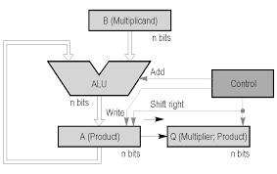
Shift-and-Add Multiplication

Slide 56
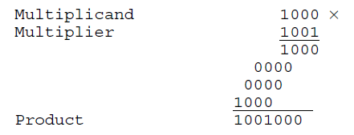
Shift-and-Add Multiplier
As an example, consider the multiplication of two unsigned 4-bit numbers,
8 (1000) and 9 (1001).

Slide 57
Shift-and-Add Multiplier
In the case of binary multiplication, since the digits are 0 and 1, each step of the multiplication is simple.
If the multiplier digit is 1, a copy of the multiplicand (1 ×multiplicand) is placed in the proper positions;
If the multiplier digit is 0, a number of 0 digits (0 × multiplicand) are placed in the proper positions.
Consider the multiplication of positive numbers. The first version of the multiplier circuit, which implements the shift-and-add multiplication method for two n-bit numbers, is shown in Figure.

Slide 58
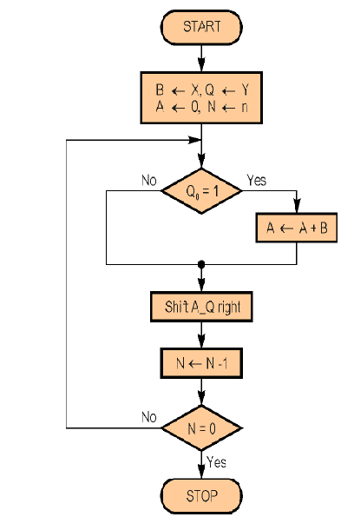
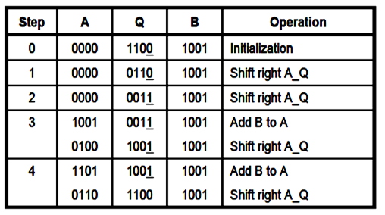
Shift - and - Add multiplier
Q= Q3Q2Q1Q0
12 x 9=108 = 01101100

Slide 59
Shift-and-Add Multiplier
For Example, Perform the multiplication 9 x 12
(1001 x 1100). Finally, both A and Q contains the result of product.

Slide 60
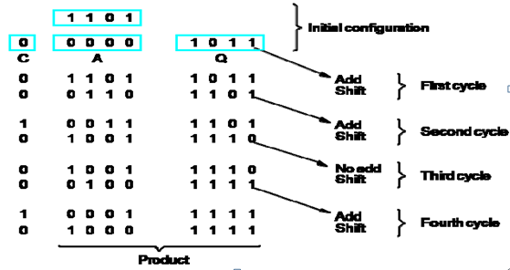
Shift-and-Add Multiplier
Example 2:
A = 0000 M ( Multiplicand) → 13 ( 1 1 0 1) Q(Multiplier) → 11 (1 0 1 1).

Slide 61
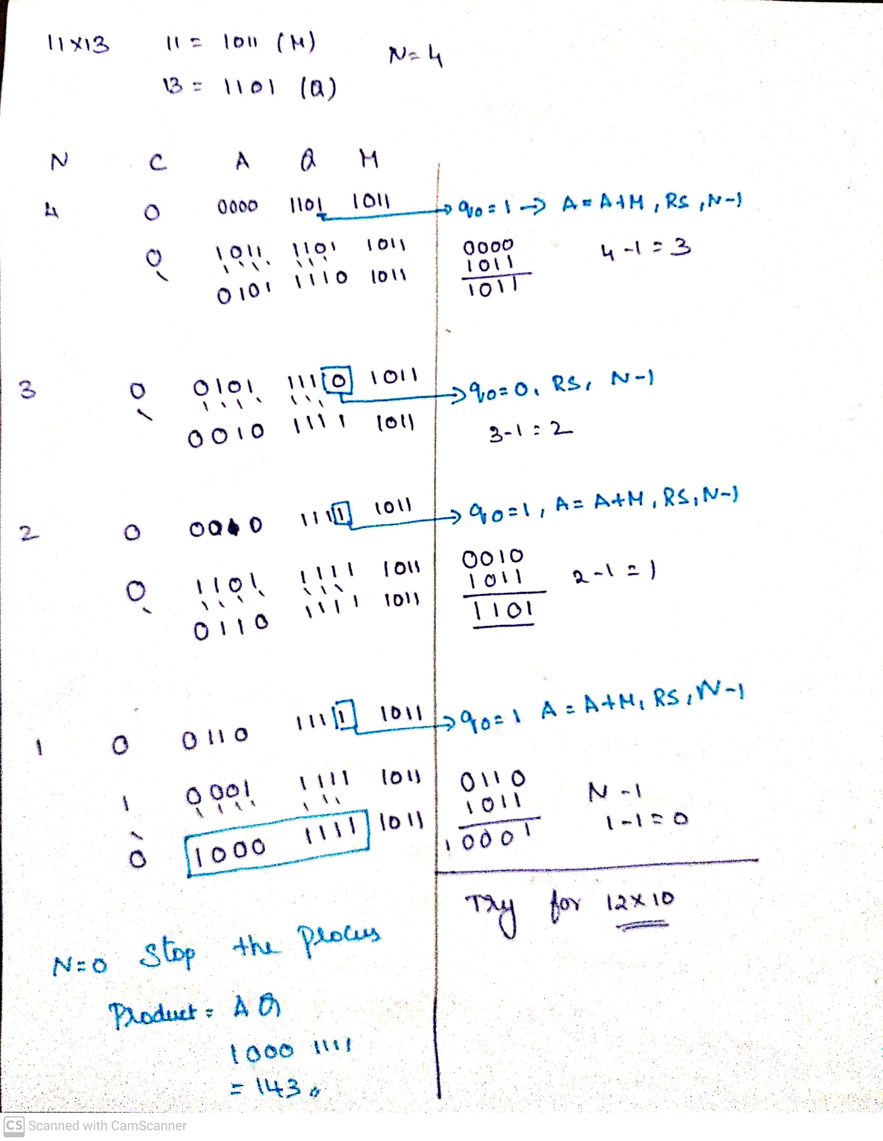
Example to multiply 11 and 13

Slide 62
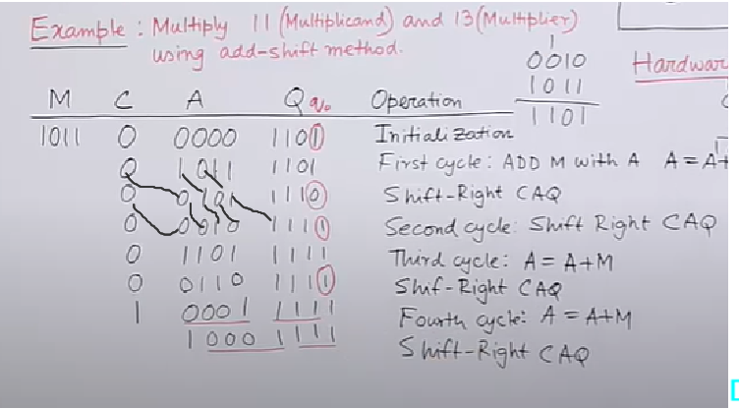
Example to multiply 11 and 13

Slide 63
Signed Multiplication - Booth Algorithm
A powerful algorithm for signed number multiplication is Booth’s algorithm which generates a 2n bit product and treats both positive and negative numbers uniformly.
This algorithm suggest that we can reduce the number of operations required for multiplication by representing multiplier as a difference between two numbers.

Slide 64
Signed Multiplication - Booth Algorithm
A powerful algorithm for signed number multiplication is Booth’s algorithm which generates a 2n bit product and treats both positive and negative numbers uniformly.
This algorithm suggest that we can reduce the number of operations required for multiplication by representing multiplier as a difference between two numbers.

Slide 65
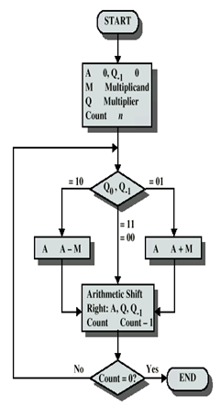
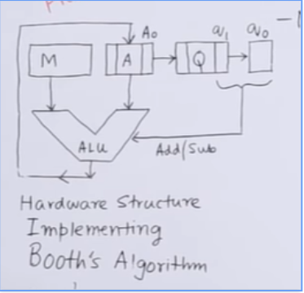
Signed Multiplication - Booth Algorithm

Slide 66
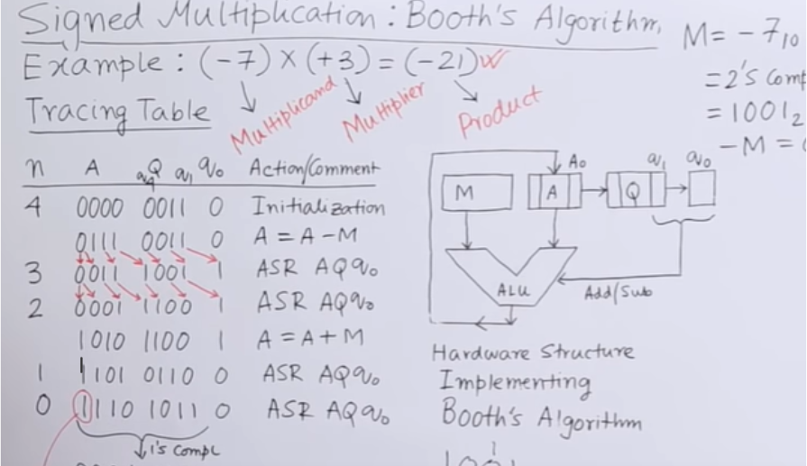
Signed Multiplication - Booth Algorithm

Slide 67
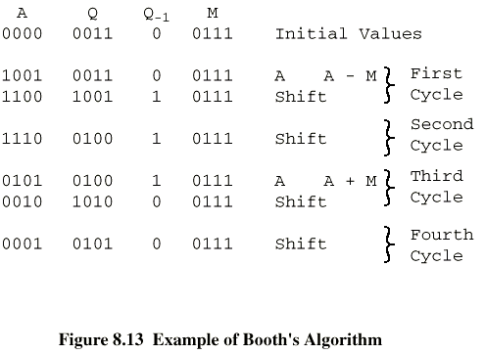
Signed Multiplication - Booth Algorithm

Slide 68
A,Q,M,Q1 7X3=? 21
00010101=1+0+4+0+16+0+0)=21
STEPS | A | Q | Q1 | M | OPERATIONS
4 | 0000 | 0011 | 0 | 0111 | INITIATIALISATION
3 | 1001 1 1 0 0 | 0011 1 001 | 0 1 | 0111 | A=A-M ARI RIGHT SHIFT
2 | 1 110 | 0 100 | 1 | 0111 | ARI R SHIFT
1 | 0101 0 010 | 0100 1010 | 1 0 | 0111 | A=A+M ARI R SHIFT
0 | 0001 | 0101 | 0 | 0111 | ARI R SHIFT

Slide 70
A,Q,M,Q1 0111 1001 -7X3=? -21
1101011=-21
STEPS | A | Q | Q1 | M | OPERATIONS
4 | 0000 | 0011 | 0 | 1001 | INITIATIALISATION
3 | 0111 0011 | 0011 1001 | 0 1 | 1001 | A=A-M ASR
2 | 0 001 | 1 100 | 1 | 1001 | ASR
1 | 1010 1 101 | 1100 0 110 | 1 0 | 1001 | A=A+M ASR
0 | 1 110 | 1011 | 0 | 1001 | ASR

Slide 71
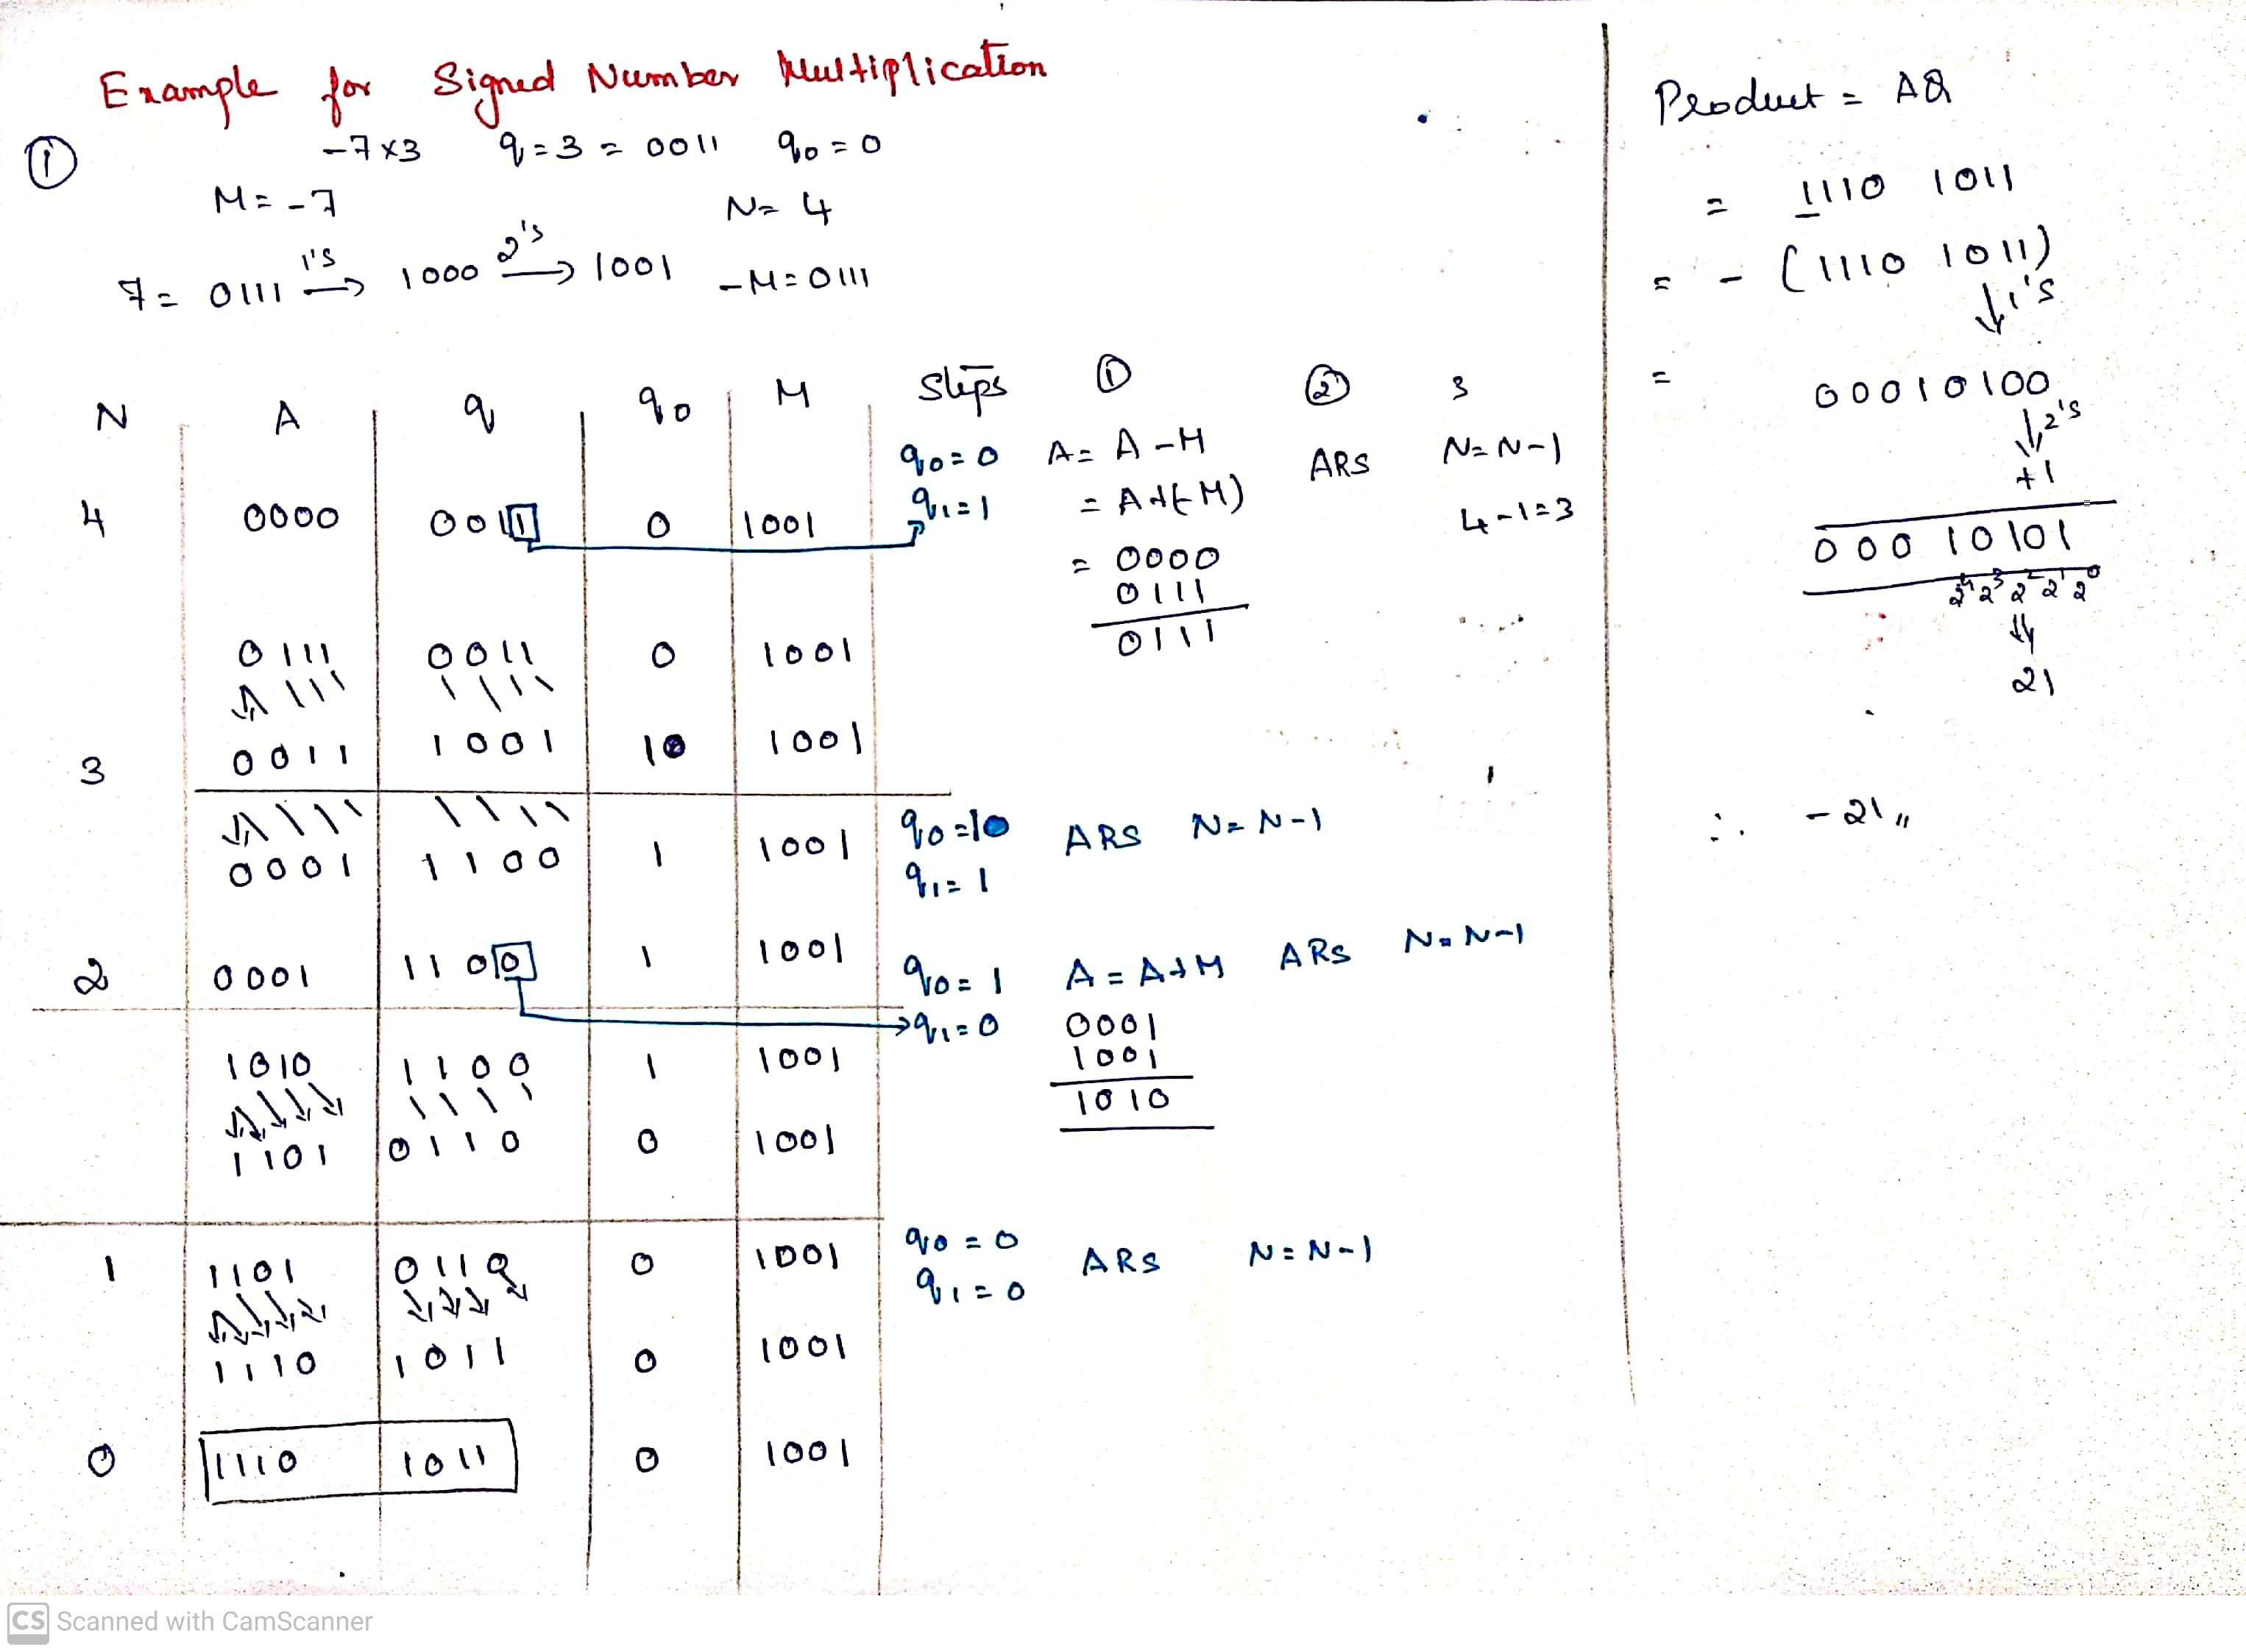

Slide 72
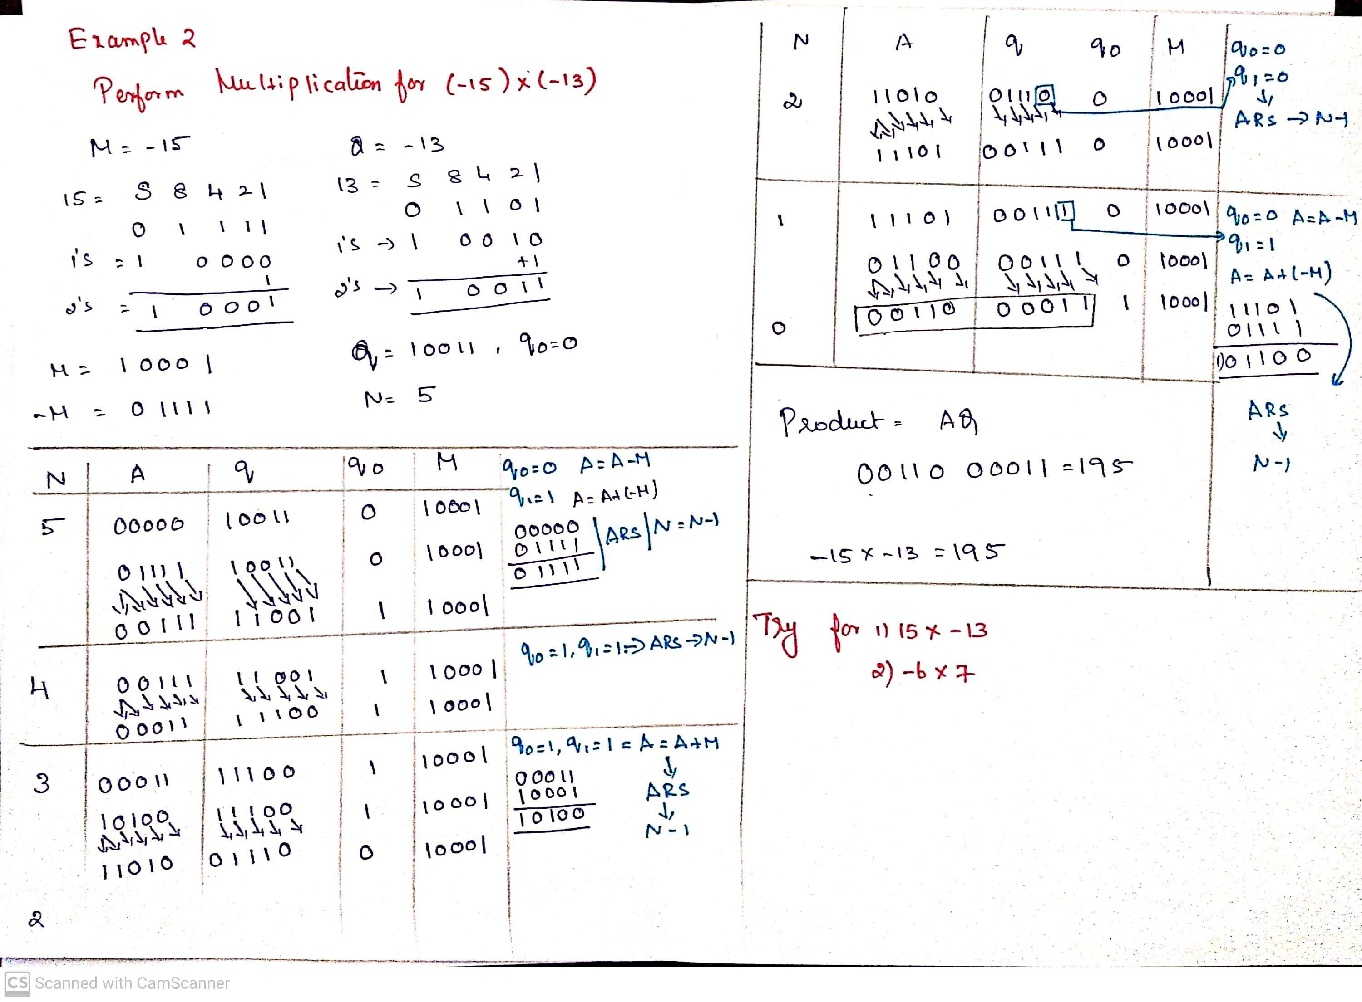

Slide 73
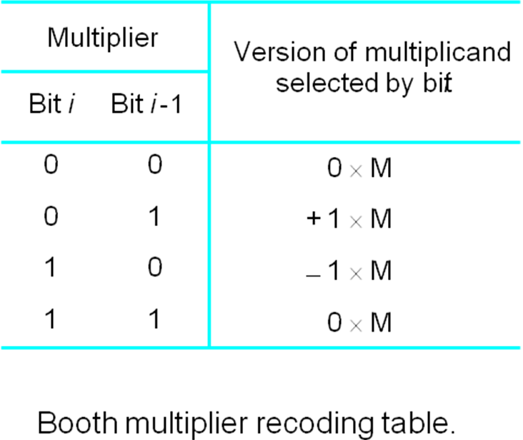
Alternate Method : The BOOTH Algorithm
Booth multiplication reduces the number of additions for intermediate results, but can sometimes make it worse as we will see.
Booth multiplier recoding table

Slide 74
The BOOTH RECODED MULTIPLIER
Booth Recoding:
30₁₀ : 0 1 1 1 1 0 0
+1 0 0 0 -1 0
(ii) 100₁₀: 0 1 1 0 0 1 0 0 0
+1 0 -1 0 +1 -1 0 0
(iii) 985₁₀: 0 0 1 1 1 1 0 1 1 0 0 1 0
0 +1 0 0 0 -1 +1 0 -1 0 +1 -1

Slide 75
(30)= (30)₁₀ = 0 1 1 1 1 0 0

Slide 76
100= 0 1 1 0 0 1 0 0 0

Slide 77
-13 x +11
Step 1:Multiplier Recoding
13=01101
-(13)= 10010=1 0 0 1 1
Step2

Slide 78
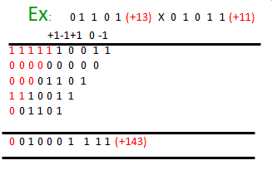
BOOTH Algorithm
Booth algorithm treats both +ve &
-ve operands equally.
(a) + Md X + Mr

Slide 79

BOOTH Algorithm
Booth algorithm treats both +ve &
-ve operands equally.
(b) - Md X + Mr

Slide 80

BOOTH Algorithm
Booth algorithm treats both +ve &
-ve operands equally.
(c) + Md X - Mr

Slide 81

BOOTH Algorithm
Booth algorithm treats both +ve &
-ve operands equally.
(d) - Md X - Mr

Slide 82

BOOTH Algorithm

Slide 83


Slide 84
FAST MULTIPLICATION
1.BIT PAIR RECODING OF MULTIPLIERS 2.CARRY SAVE ADDITION OF SUMMANDS

Slide 85
Fast Multiplication
There are two techniques for speeding up the multiplication operation.
The first technique guarantees that the maximum number of summands (versions of the multiplicand) that must be added is n/2 for n-bit operands.
The second technique reduces the time needed to add the summands (carry-save addition of summands method).

Slide 86
Bit-Pair Recoding of Multipliers
This bit-pair recoding technique halves the maximum number of summands. It is derived from the Booth algorithm.
Group the Booth-recoded multiplier bits in pairs, and observe the following: The pair (+1 -1) is equivalent to the pair (0 +1).
That is, instead of adding —1 times the multiplicand M at shift position i to + 1 x M at position i + 1, the same result is obtained by adding +1 x M at position I Other examples are: (+1 0) is equivalent to (0 +2),(-l +1) is equivalent to (0 —1). and so on

Slide 87



Bit-Pair Recoding of Multipliers

Slide 90


Bit-Pair Recoding of Multipliers

Slide 91


Slide 92

Bit-Pair Recoding of Multipliers

Slide 93

Figure 1: Basic Scheme for Fast Multiplication

Slide 94

Carry-Save Addition of Summands
A carry-save adder is a type of digital adder, used to efficiently compute the sum of three or more binary numbers.
A carry-save adder (CSA), or 3-2 adder, is a very fast and cheap adder that does not propagate carry bits.
A Carry Save Adder is generally used in binary multiplier, since a binary multiplier involves addition of more than two binary numbers after multiplication.
It can be used to speed up addition of the several summands required in multiplication
It differs from other digital adders in that it outputs two (or more) numbers, and the answer of the original summation can be achieved by adding these outputs together.
A big adder implemented using this technique will usually be much faster than conventional addition of those numbers.
Fast Multiplication
Bit pair recoding reduces summands by a factor of 2
Summands are reduced by carry save addition
Final product can be generated by using carry look ahead adder

Slide 95
Carry-Save Addition of Summands
Disadvantage of the Ripple Carry Adder - Each full adder has to wait for its carry-in from its previous stage full adder. This increase propagation time. This causes a delay and makes ripple carry adder extremely slow. RCAr is very slow when adding many bits.
Advantage of the Carry Look ahead Adder - This is an improved version of the Ripple Carry Adder. Fast parallel adder. It generates the carry-in of each full adder simultaneously without causing any delay. So, CLAr is faster (because of reduced propagation delay) than RCAr.
Disadvantage the Carry Look-ahead Adder - It is costlier as it reduces the propagation delay by more complex hardware. It gets more complicated as the number of bits increases.
Notes:
Propagation delay is time elapsed between the submission of an input and occurrence of the corresponding output.

Slide 96

Ripple Carry Array

Slide 97

Carry Save Array

Slide 98
Carry-Save Addition of Summands
Consider the addition of many summands, We can:
Group the summands in threes and perform carry-save addition on each of these groups in parallel to generate a set of S and C vectors in one full-adder delay
Group all of the S and C vectors into threes, and perform carry-save addition of them, generating a further set of S and C vectors in one more full-adder delay
Continue with this process until there are only two vectors remaining
They can be added in a Ripple Carry Adder (RPA) or Carry Look-ahead Adder (CLA) to produce the desired product

Slide 99


Slide 100


Slide 101


Slide 103

Integer Division
Decimal Division and Binary Division
Figure: Longhand division examples

Slide 104

Integer Division

Slide 105
Integer Division
Longhand Division operates as follows:
Position the divisor appropriately with respect to the dividend and performs a subtraction.
If the remainder is zero or positive, a quotient bit of 1 is determined, the remainder is extended by another bit of the dividend, the divisor is repositioned, and another subtraction is performed.
If the remainder is negative, a quotient bit of 0 is determined, the dividend is restored by adding back the divisor, and the divisor is repositioned for another subtraction

Slide 106
Restoring Division
Similar to multiplication circuit
An n-bit positive divisor is loaded into register M and an n-bit positive dividend is loaded into register Q at the start of the operation.
Register A is set to 0
After the division operation is complete, the n-bit quotient is in register Q and the remainder is in register A.
The required subtractions are facilitated by using 2’s complement arithmetic.
The extra bit position at the left end of both A and M accommodates the sign bit during subtractions.

Slide 107

Restoring Division
Figure: Logic Circuit arrangement for binary Division (Restoring)

Slide 108

Restoring Division
Figure: Flowchart for Restoring Division

Slide 109
8/3
Q=2=R

Slide 110
0100 =4 = 8

Slide 111

Restoring Division

Slide 112

Restoring Division

Slide 113
Non-Restoring Division
An n-bit positive divisor is loaded into register M and an n-bit positive dividend is loaded into register Q at the start of the operation.
Register A is set to 0
After the division operation is complete, the n-bit quotient is in register Q and the remainder is in register A.
Step 1: Do the following n times:
1.If the sign of A is 0, shift A and Q left one bit position and subtract M from A; otherwise, shift A and Q left and add M to A.
2.Now, if the sign of A is 0, set q0 to 1; otherwise, set q0 to 0.
Step 2: If the sign of A is 1, add M to A.

Slide 114

Non-Restoring Division
Figure: Flowchart for Non-Restoring Division

Slide 115
33.3=? Binary
33+.3=

Slide 116

Non-Restoring Division

Slide 117

Non-Restoring Division

Slide 118
Floating point numbers and operations

Slide 119
Floating Point Numbers and Operations
Floating Point Number Representation (FPR)
±Significant x Base^{±Exponent}
Example: +10.55 x 10⁵⁵
Why FPR?
Consider a very small number 0.00000000005
As it consists of many 0’s after the decimal point, it
requires more number bits for representation
0.00000000005 is represented as 0.5 x 10⁻¹⁰, it will require only fewer bits
Consider a very large number 50000000000 which can be represented as 5 x 10¹⁰ ⁽⁺⁵
Consider the example 0.123 x 10⁴ = 0.0123 x 10⁵ = 123 x 10³
But we need a fixed and single representation for floating point numbers. For this normalization is required.

Slide 120
Distribution of Floating Point Numbers
3 bit mantissa
exponent {-1,0,1}
0
1
2
3
120
Notes:
September 4, 1997
120

Slide 121
Floating Point Standard
Defined by IEEE Std 754-1985
Developed in response to divergence of representations
Portability issues for scientific code
Now almost universally adopted
Two representations
Single precision (32-bit)
Double precision (64-bit)

Slide 122
Single-Precision Range
Exponents 00000000 and 11111111 reserved
Smallest value
Exponent: 00000001 ⇒ actual exponent = 1 – 127 = –126
Fraction: 000…00 ⇒ significand = 1.0
±1.0 × 2^{–126} ≈ ±1.2 × 10^{–38}
Largest value
exponent: 11111110 ⇒ actual exponent = 254 – 127 = +127
Fraction: 111…11 ⇒ significand ≈ 2.0
±2.0 × 2⁺¹²⁷ ≈ ±3.4 × 10⁺³⁸

Slide 123
Double-Precision Range
Exponents 0000…00 and 1111…11 reserved
Smallest value
Exponent: 00000000001 ⇒ actual exponent = 1 – 1023 = –1022
Fraction: 000…00 ⇒ significand = 1.0
±1.0 × 2^{–1022} ≈ ±2.2 × 10^{–308}
Largest value
Exponent: 11111111110 ⇒ actual exponent = 2046 – 1023 = +1023
Fraction: 111…11 ⇒ significand ≈ 2.0
±2.0 × 2⁺¹⁰²³ ≈ ±1.8 × 10⁺³⁰⁸

Slide 124


Floating Point Numbers and Operations
Normalization rules for floating point number
There are 2 rules:
The integer part should be 0 _{n}
0.d₁d₂...d_{n} x B^{±E} then d₁ > 0 and all d_{i} ≥ 0
^{i=2}
In the example 0.123 x 10⁴ = 0.0123 x 10⁵ = 123 x 103, the strikethrough representations are wrong with respect to normalization rules.
Two floating point representation techniques are,
Single precision (32 bits or 4 bytes)
Double precision (64 bits or 8 bytes)

Slide 125

Floating Point Numbers and Operations
Decimal number into IEEE 754 32-bit floating point number

Slide 126
Floating Point Numbers and Operations
Floating Point Arithmetic Addition/Subtraction
Steps to add/subtract two floating point numbers:
Compare the magnitudes of the exponents and make suitable alignment to the number with the smaller magnitude of exponent
Perform the addition/subtraction
Perform normalization by shifting the resulting mantissa and adjusting the resulting exponent
Example: Add 1.1100 x 2⁴ and 1.1000 x 2²
1. Alignment: 1.1000 x 2² has to be aligned to 0.0110 x 2⁴ 1.1100
2. Addition: Add the numbers to get 10.0010 x 2⁴ 0.0110
3. Normalization: Find normalized result 10.0110
0.1000 x 2⁶ (assuming 4-bits are allowed after
decimal point)

Slide 127

Floating Point Numbers and Operations
Floating Point Arithmetic Addition/Subtraction

Slide 128
Floating point addition
128
Notes:
September 4, 1997
128

Slide 129
Floating-Point Addition
Consider a 4-digit decimal example
9.999 × 10¹ + 1.610 × 10^{–1}
1. Align decimal points
Shift number with smaller exponent
9.999 × 10¹ + 0.016 × 10¹
2. Add significands
9.999 × 10¹ + 0.016 × 10¹ = 10.015 × 10¹
3. Normalize result & check for over/underflow
1.0015 × 10²
4. Round and renormalize if necessary
1.002 × 10²

Slide 130
Floating-Point Addition
Now consider a 4-digit binary example
1.000₂ × 2^{–1} + –1.110₂ × 2^{–2} (0.5 + –0.4375)
1. Align binary points
Shift number with smaller exponent
1.000₂ × 2^{–1} + –0.111₂ × 2^{–1}
2. Add significands
1.000₂ × 2^{–1} + –0.111₂ × 2–1 = 0.001₂ × 2^{–1}
3. Normalize result & check for over/underflow
1.000₂ × 2^{–4}, with no over/underflow
4. Round and renormalize if necessary
1.000₂ × 2^{–4} (no change) = 0.0625

